Slide 1
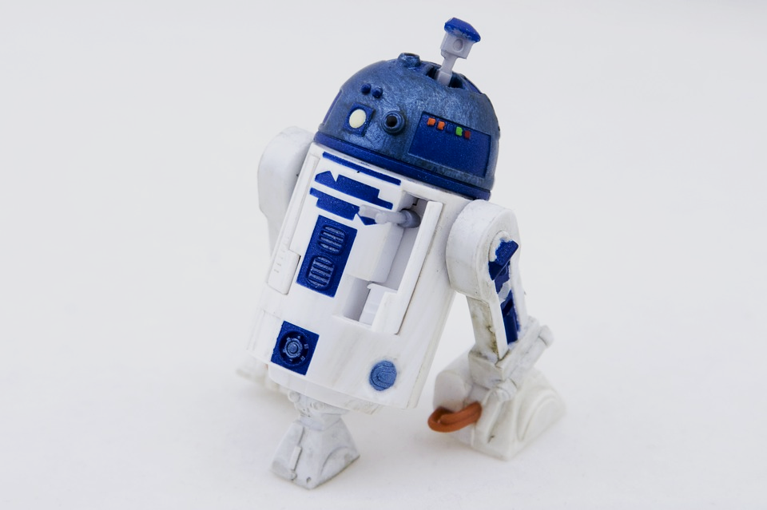
Robots and Ozobots
Charlotte, Alex and Tucker

Slide 2
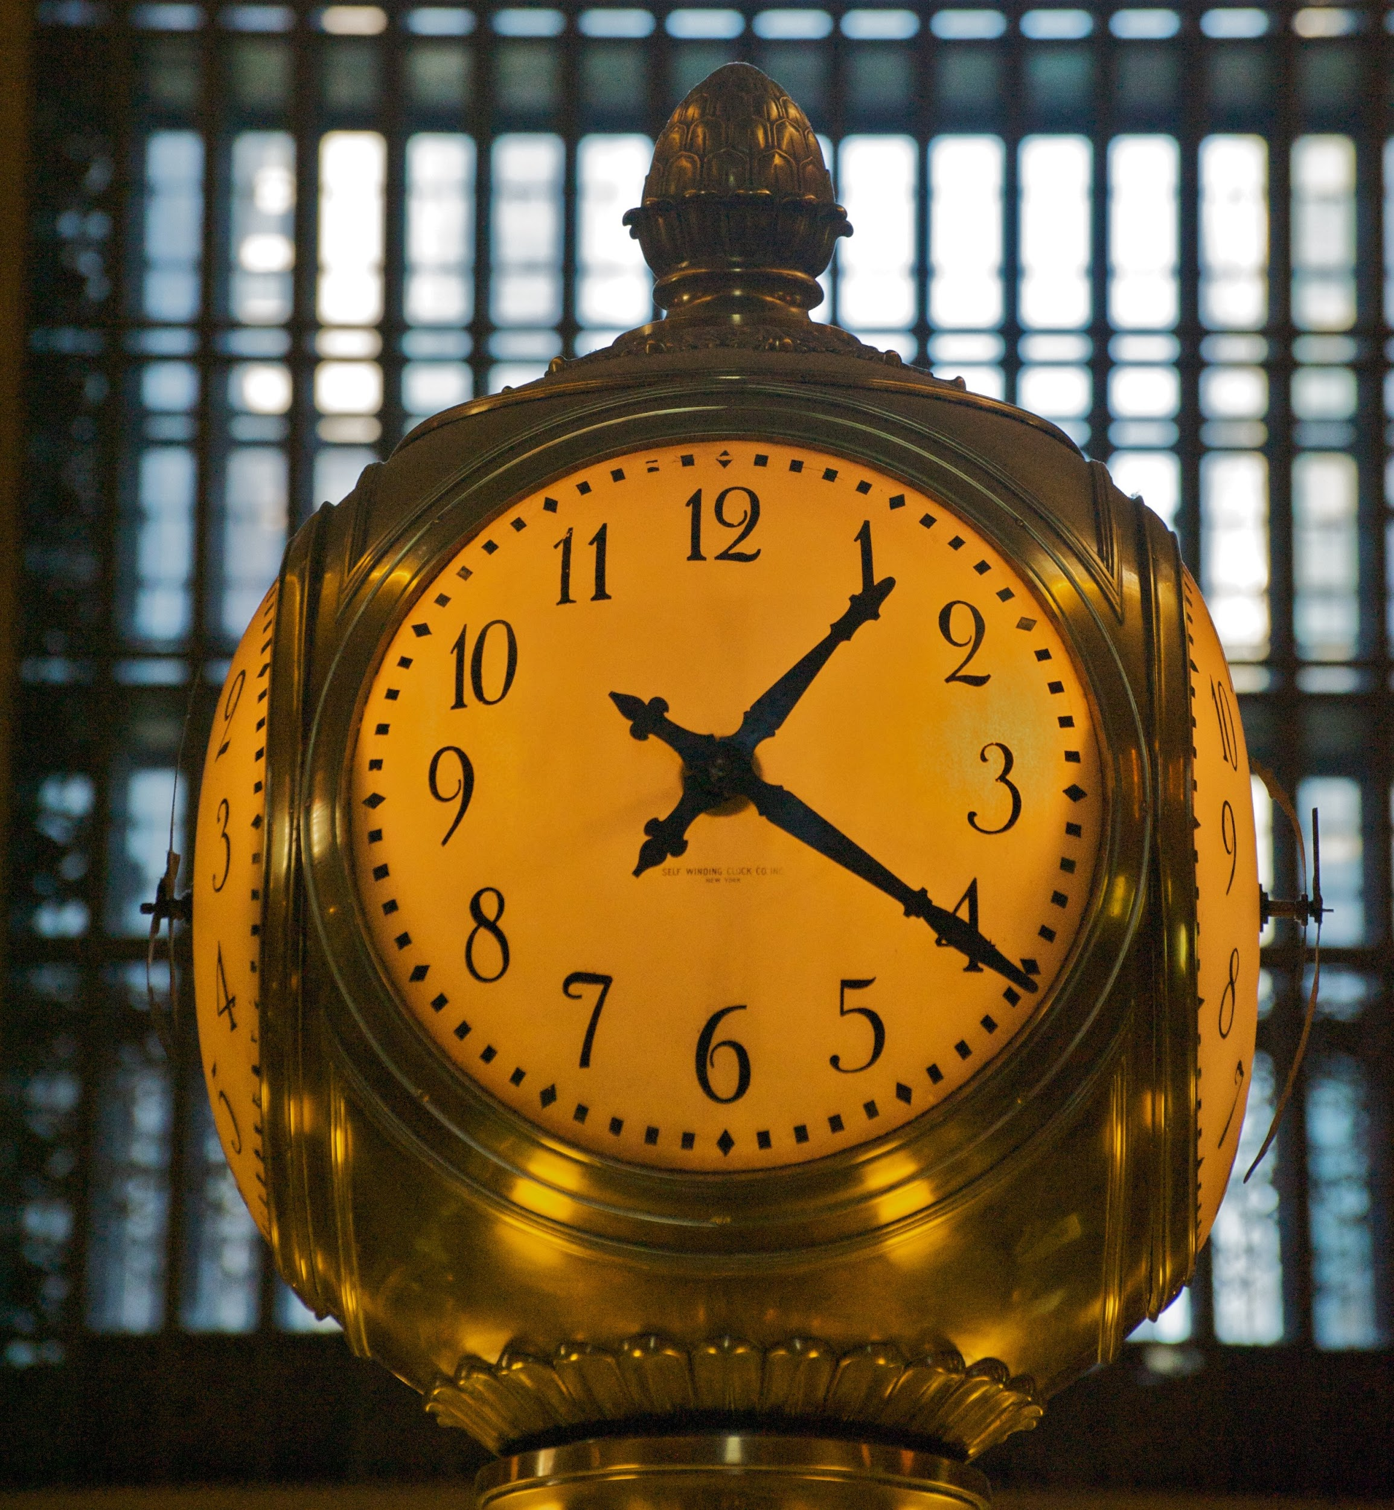
How long have robots been around for??
The idea of artificial beings have been around for thousands of years

Slide 3
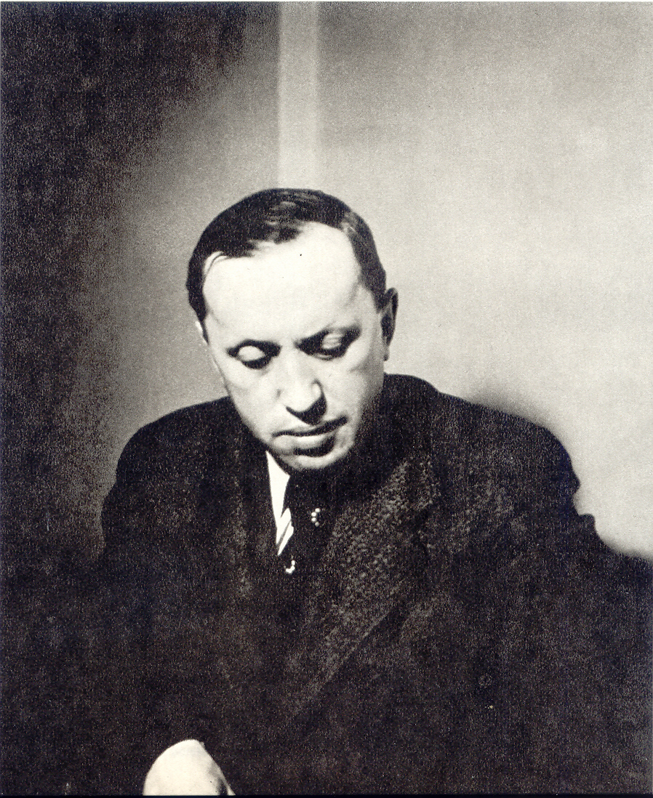
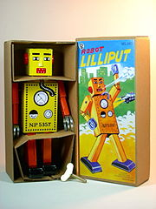
The history of robots
Karl Capek
William Grey tortoise robot
George Devol and Joseph Engelberger built first industrial robot that called Unimate
Unimate built cars on an assembly line for General Motors
Karl Capek was first to name “robot”
First true toy produced in Japan called Lilliput
Isaac Asimov wrote a story about three laws of robotics

Slide 4
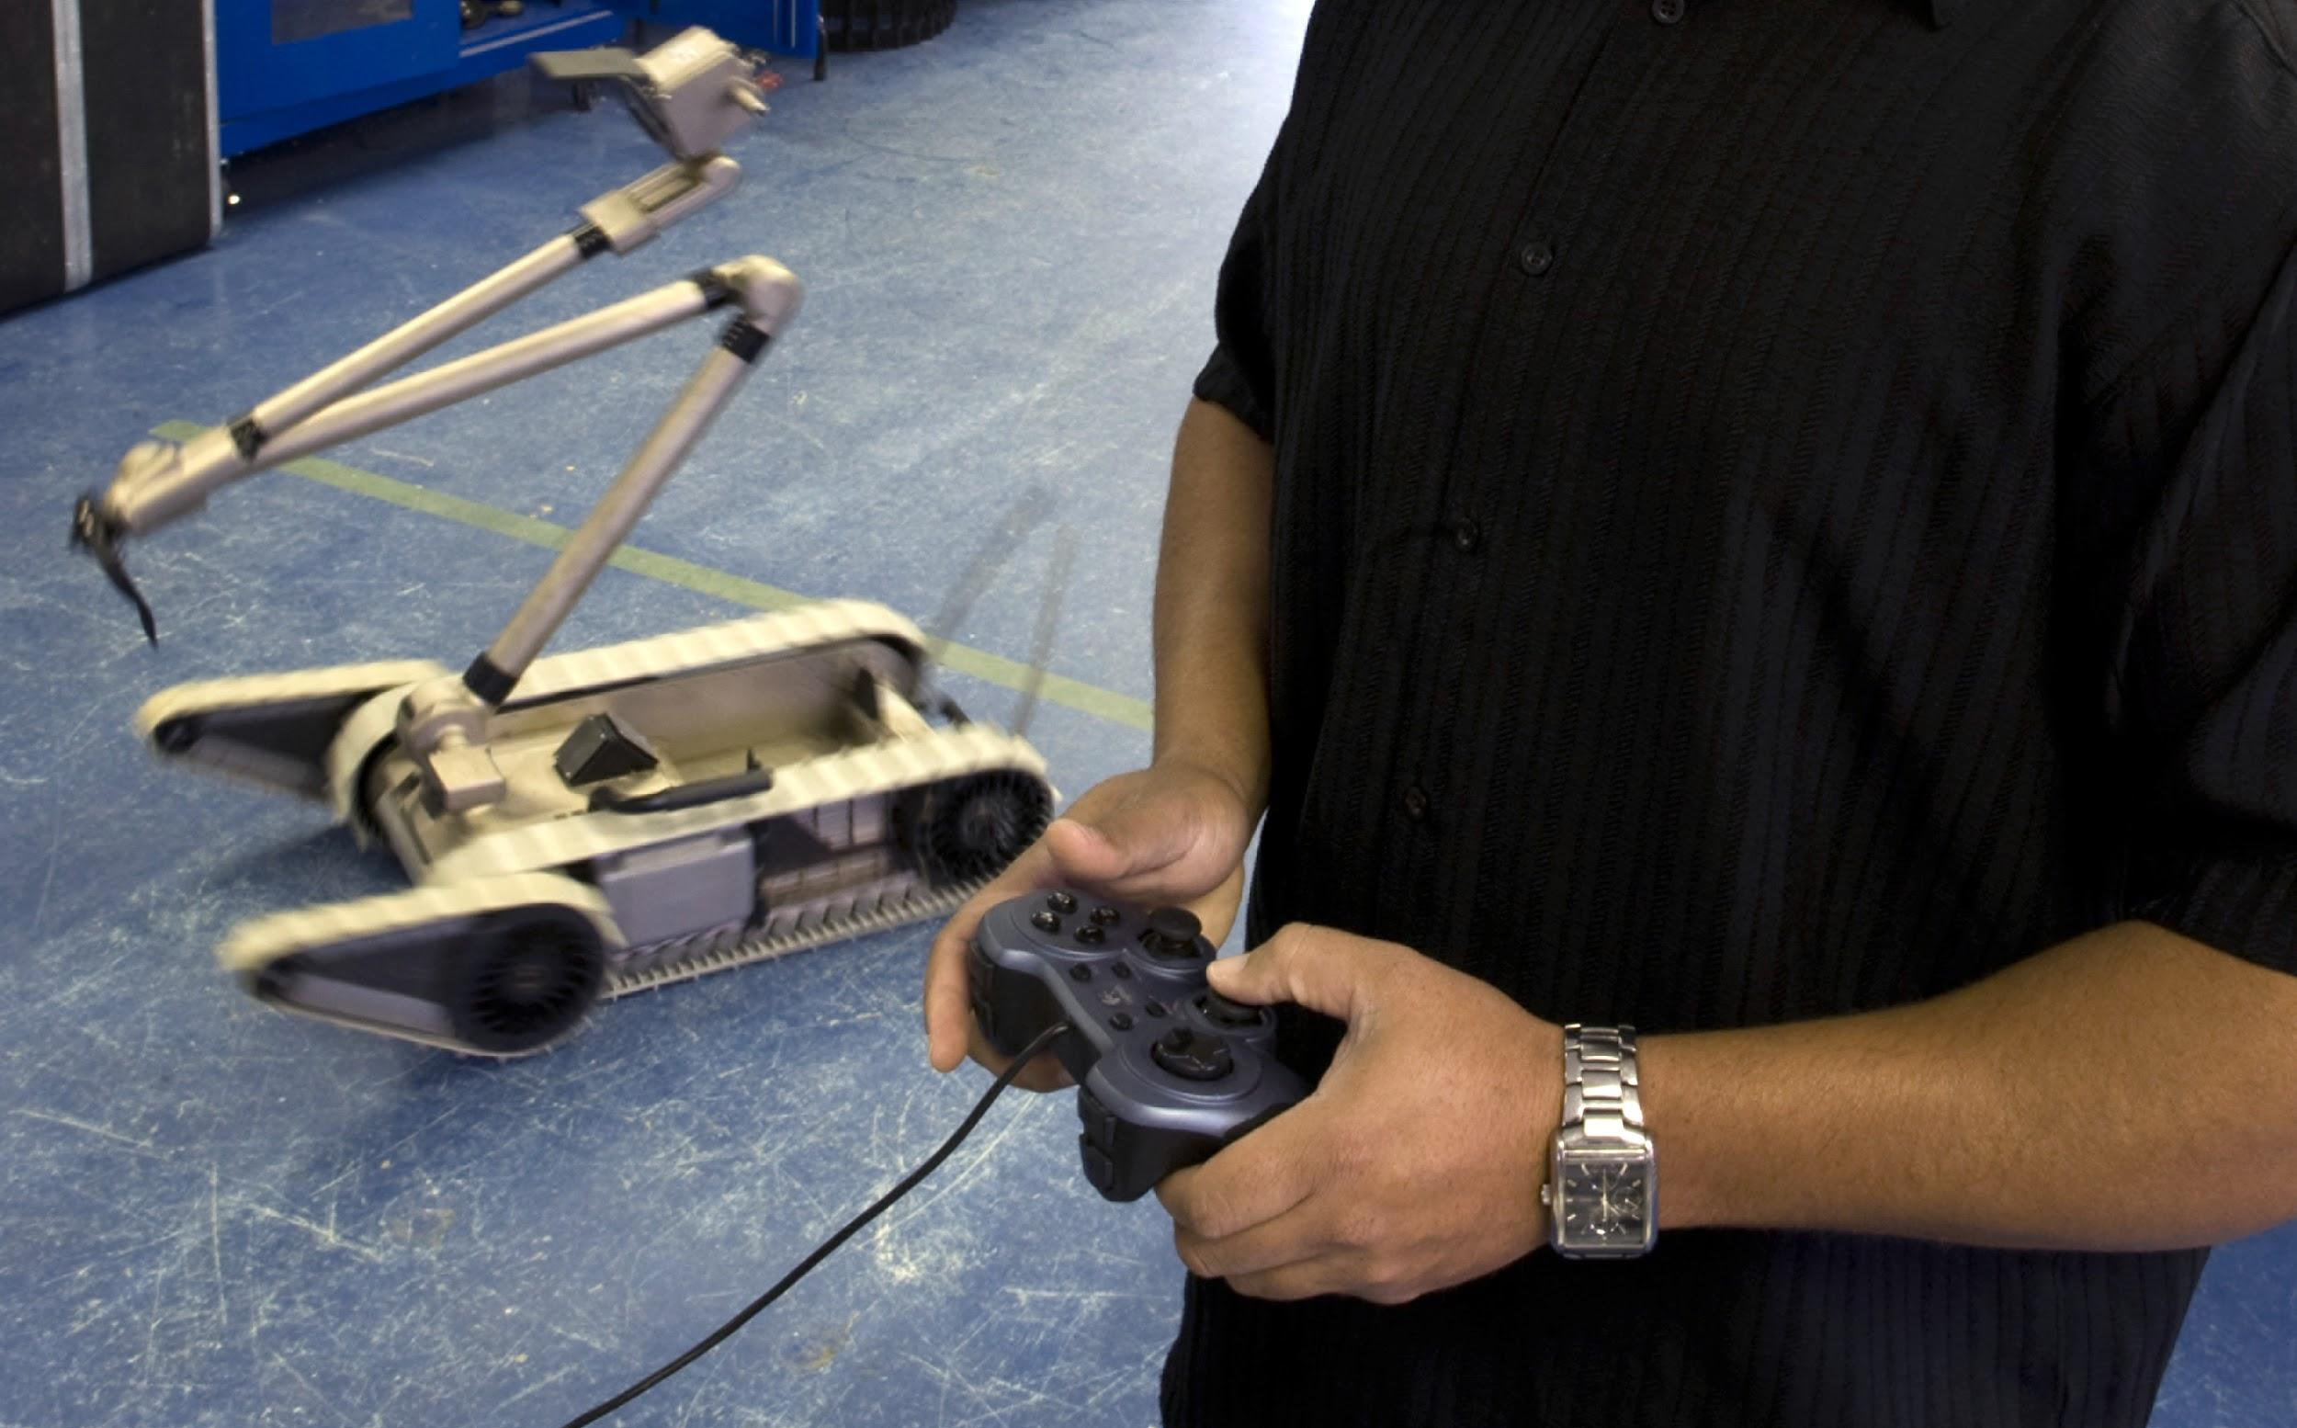
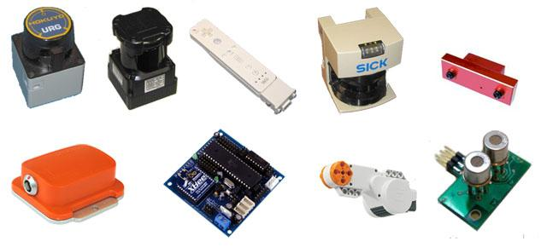
WHAT MAKES A ROBOT ??
autonomous-work by self
programs-different ways to control the robot
sensors-a device that collects information about a robot or its surroundings
controller-something that makes decisions for the robot

Slide 5
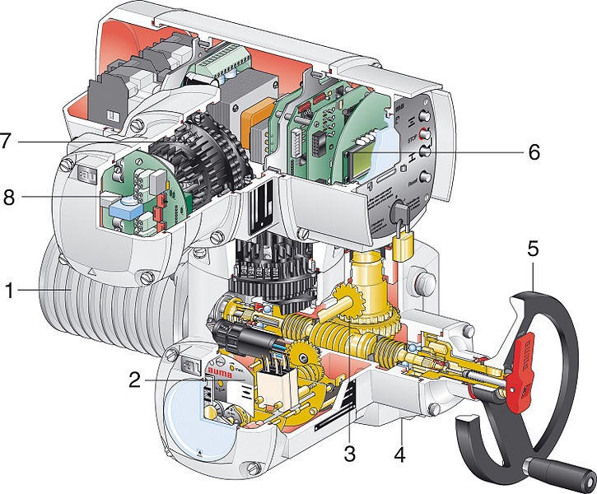
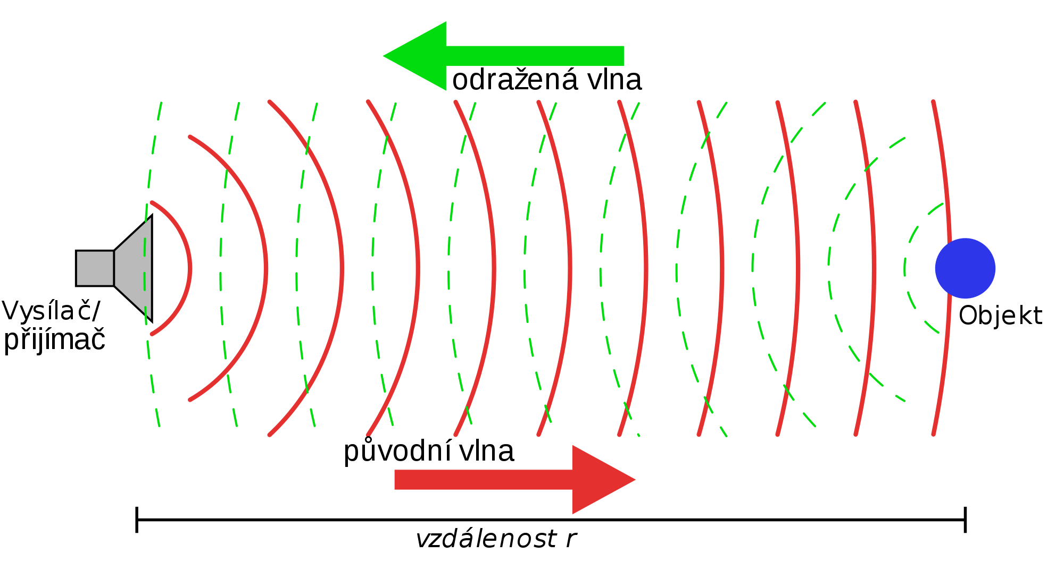
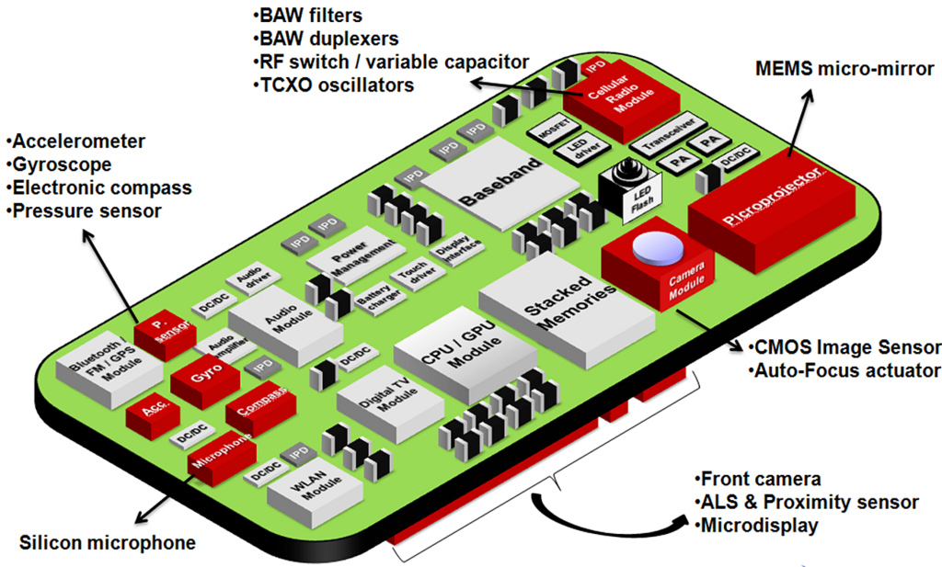
Microprocessor-it's the brain of the robot
Actuators-a system or device that controls the robot
sonar-movement by sound

Slide 6
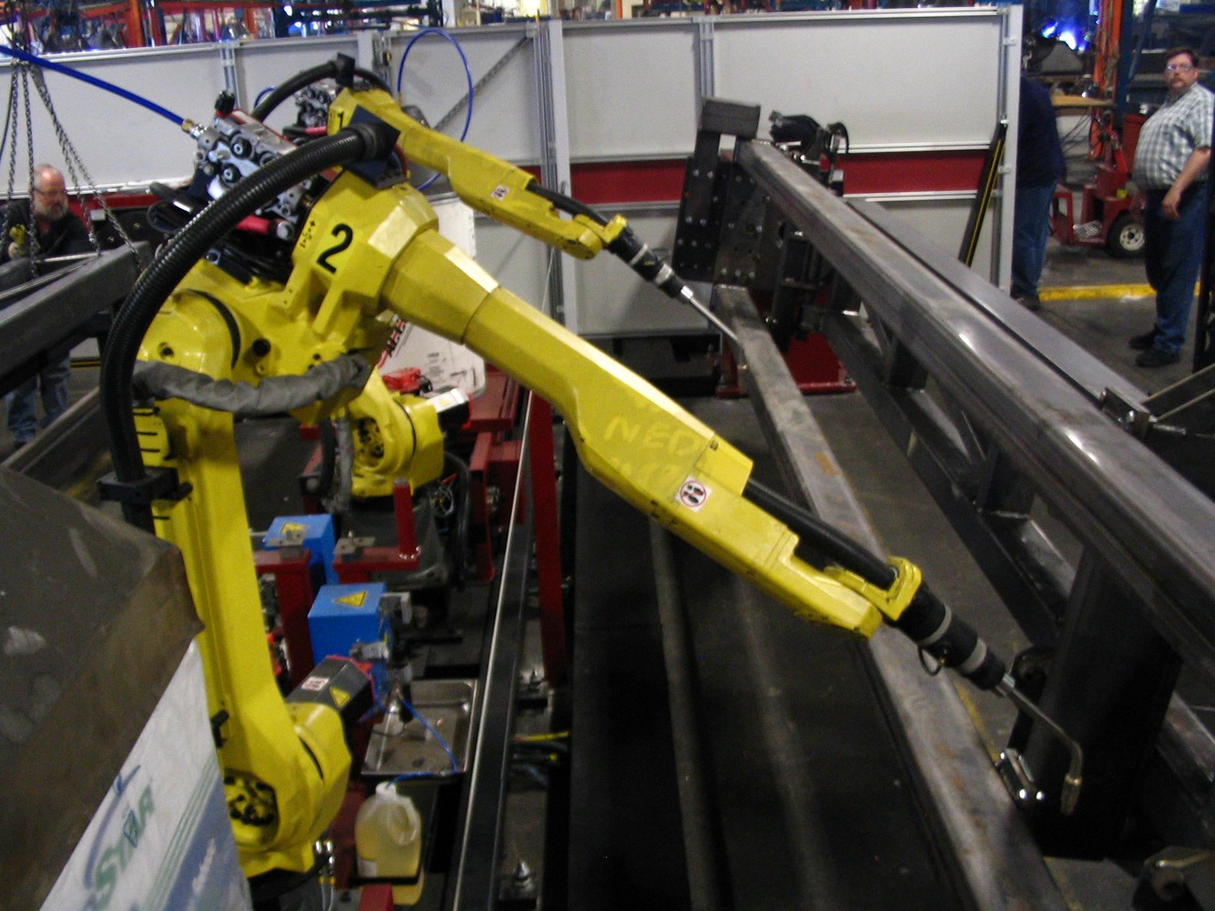
What behaviors do robots have?
Don't need to rest, are good at jobs, work 24 hours a day all year, do not get sick, rarely make mistakes, work fast, stronger than people, industrial bots repeat the job, can’t learn, can’t think, can't make decisions

Slide 7
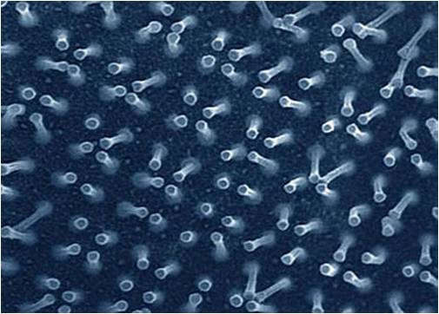
What are robots names?
Nanobot are robots that are super small

Slide 8
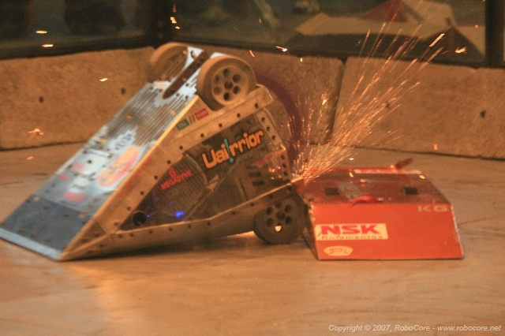
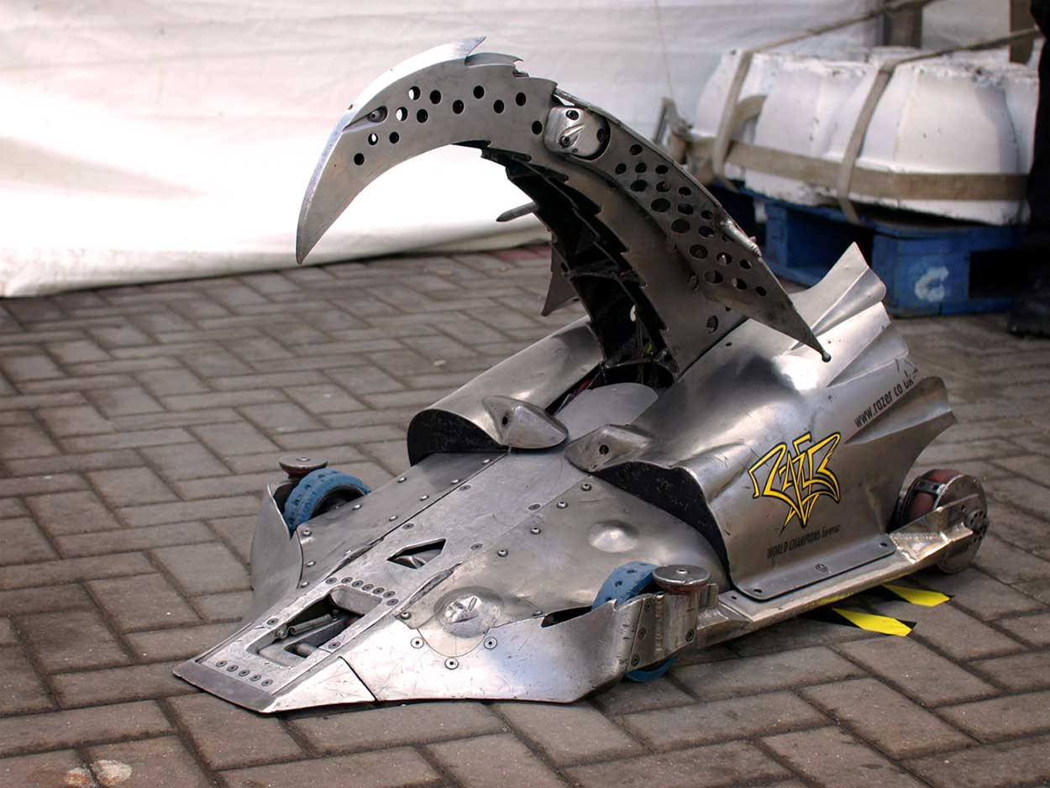
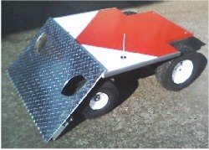
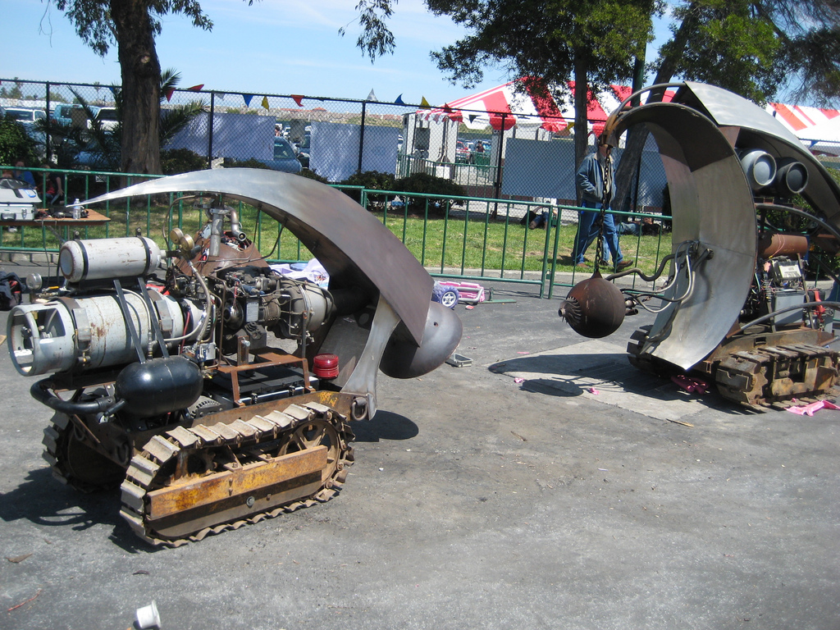
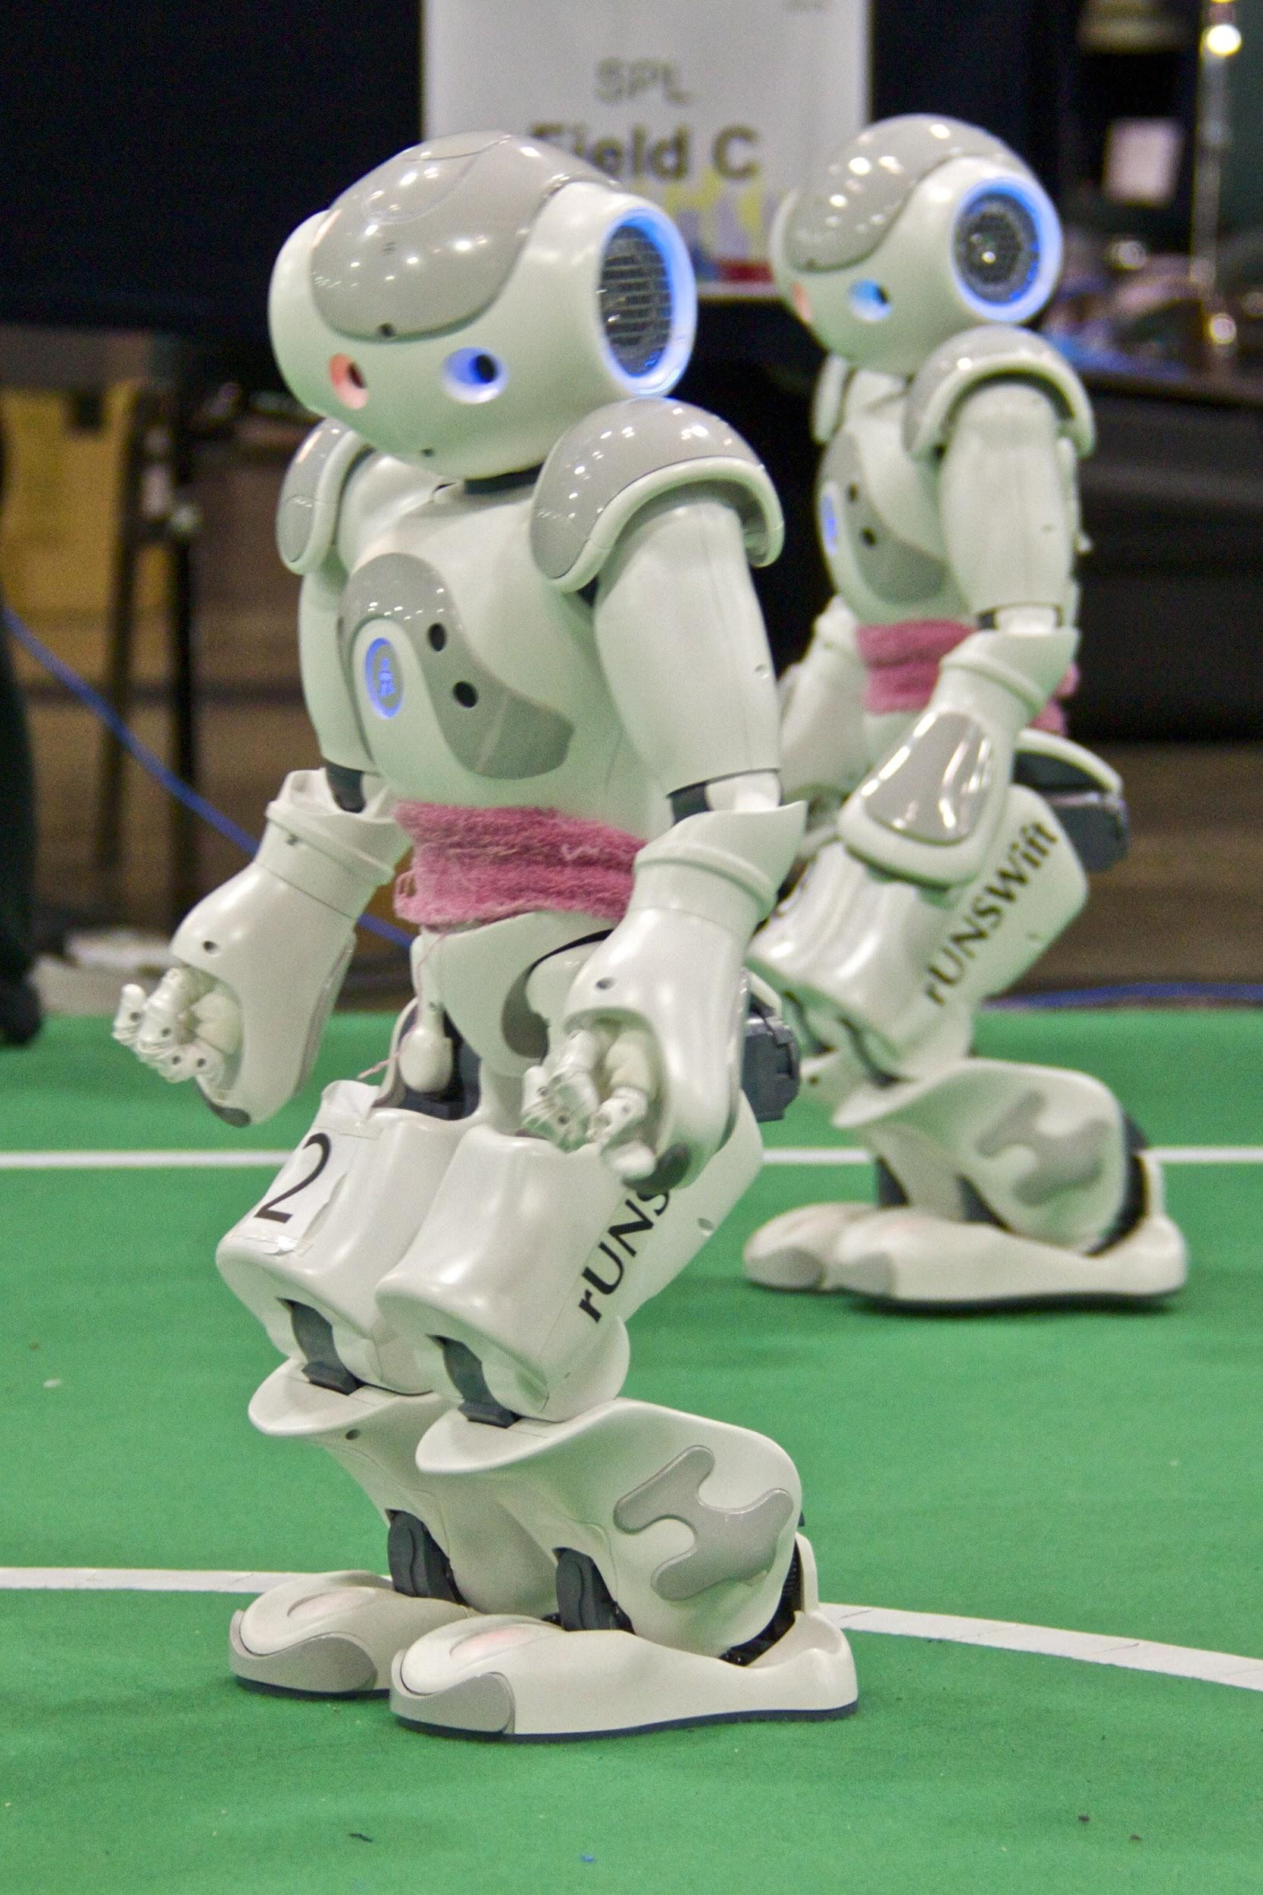
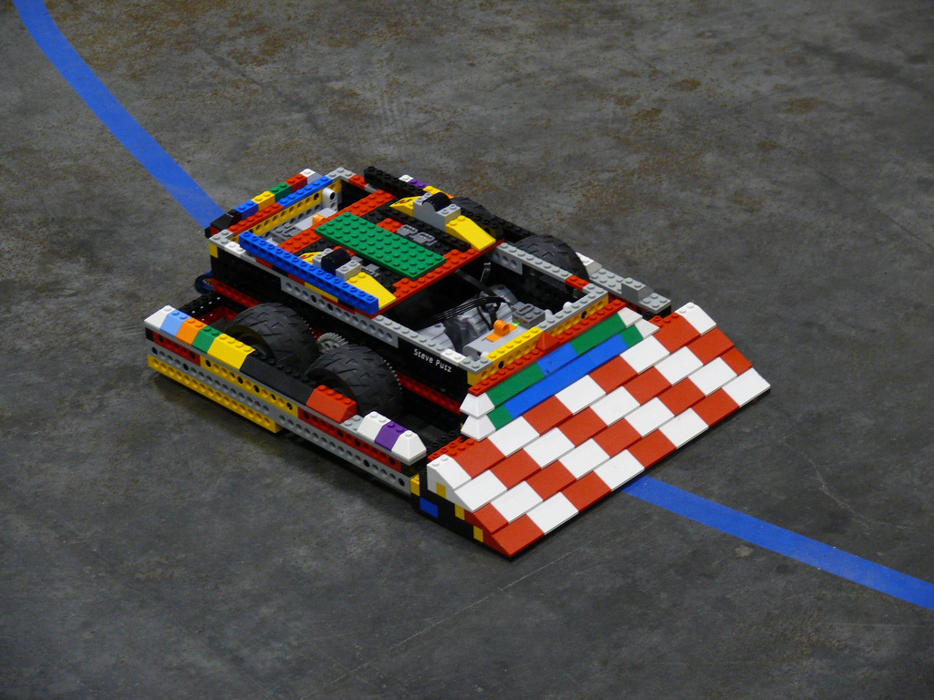
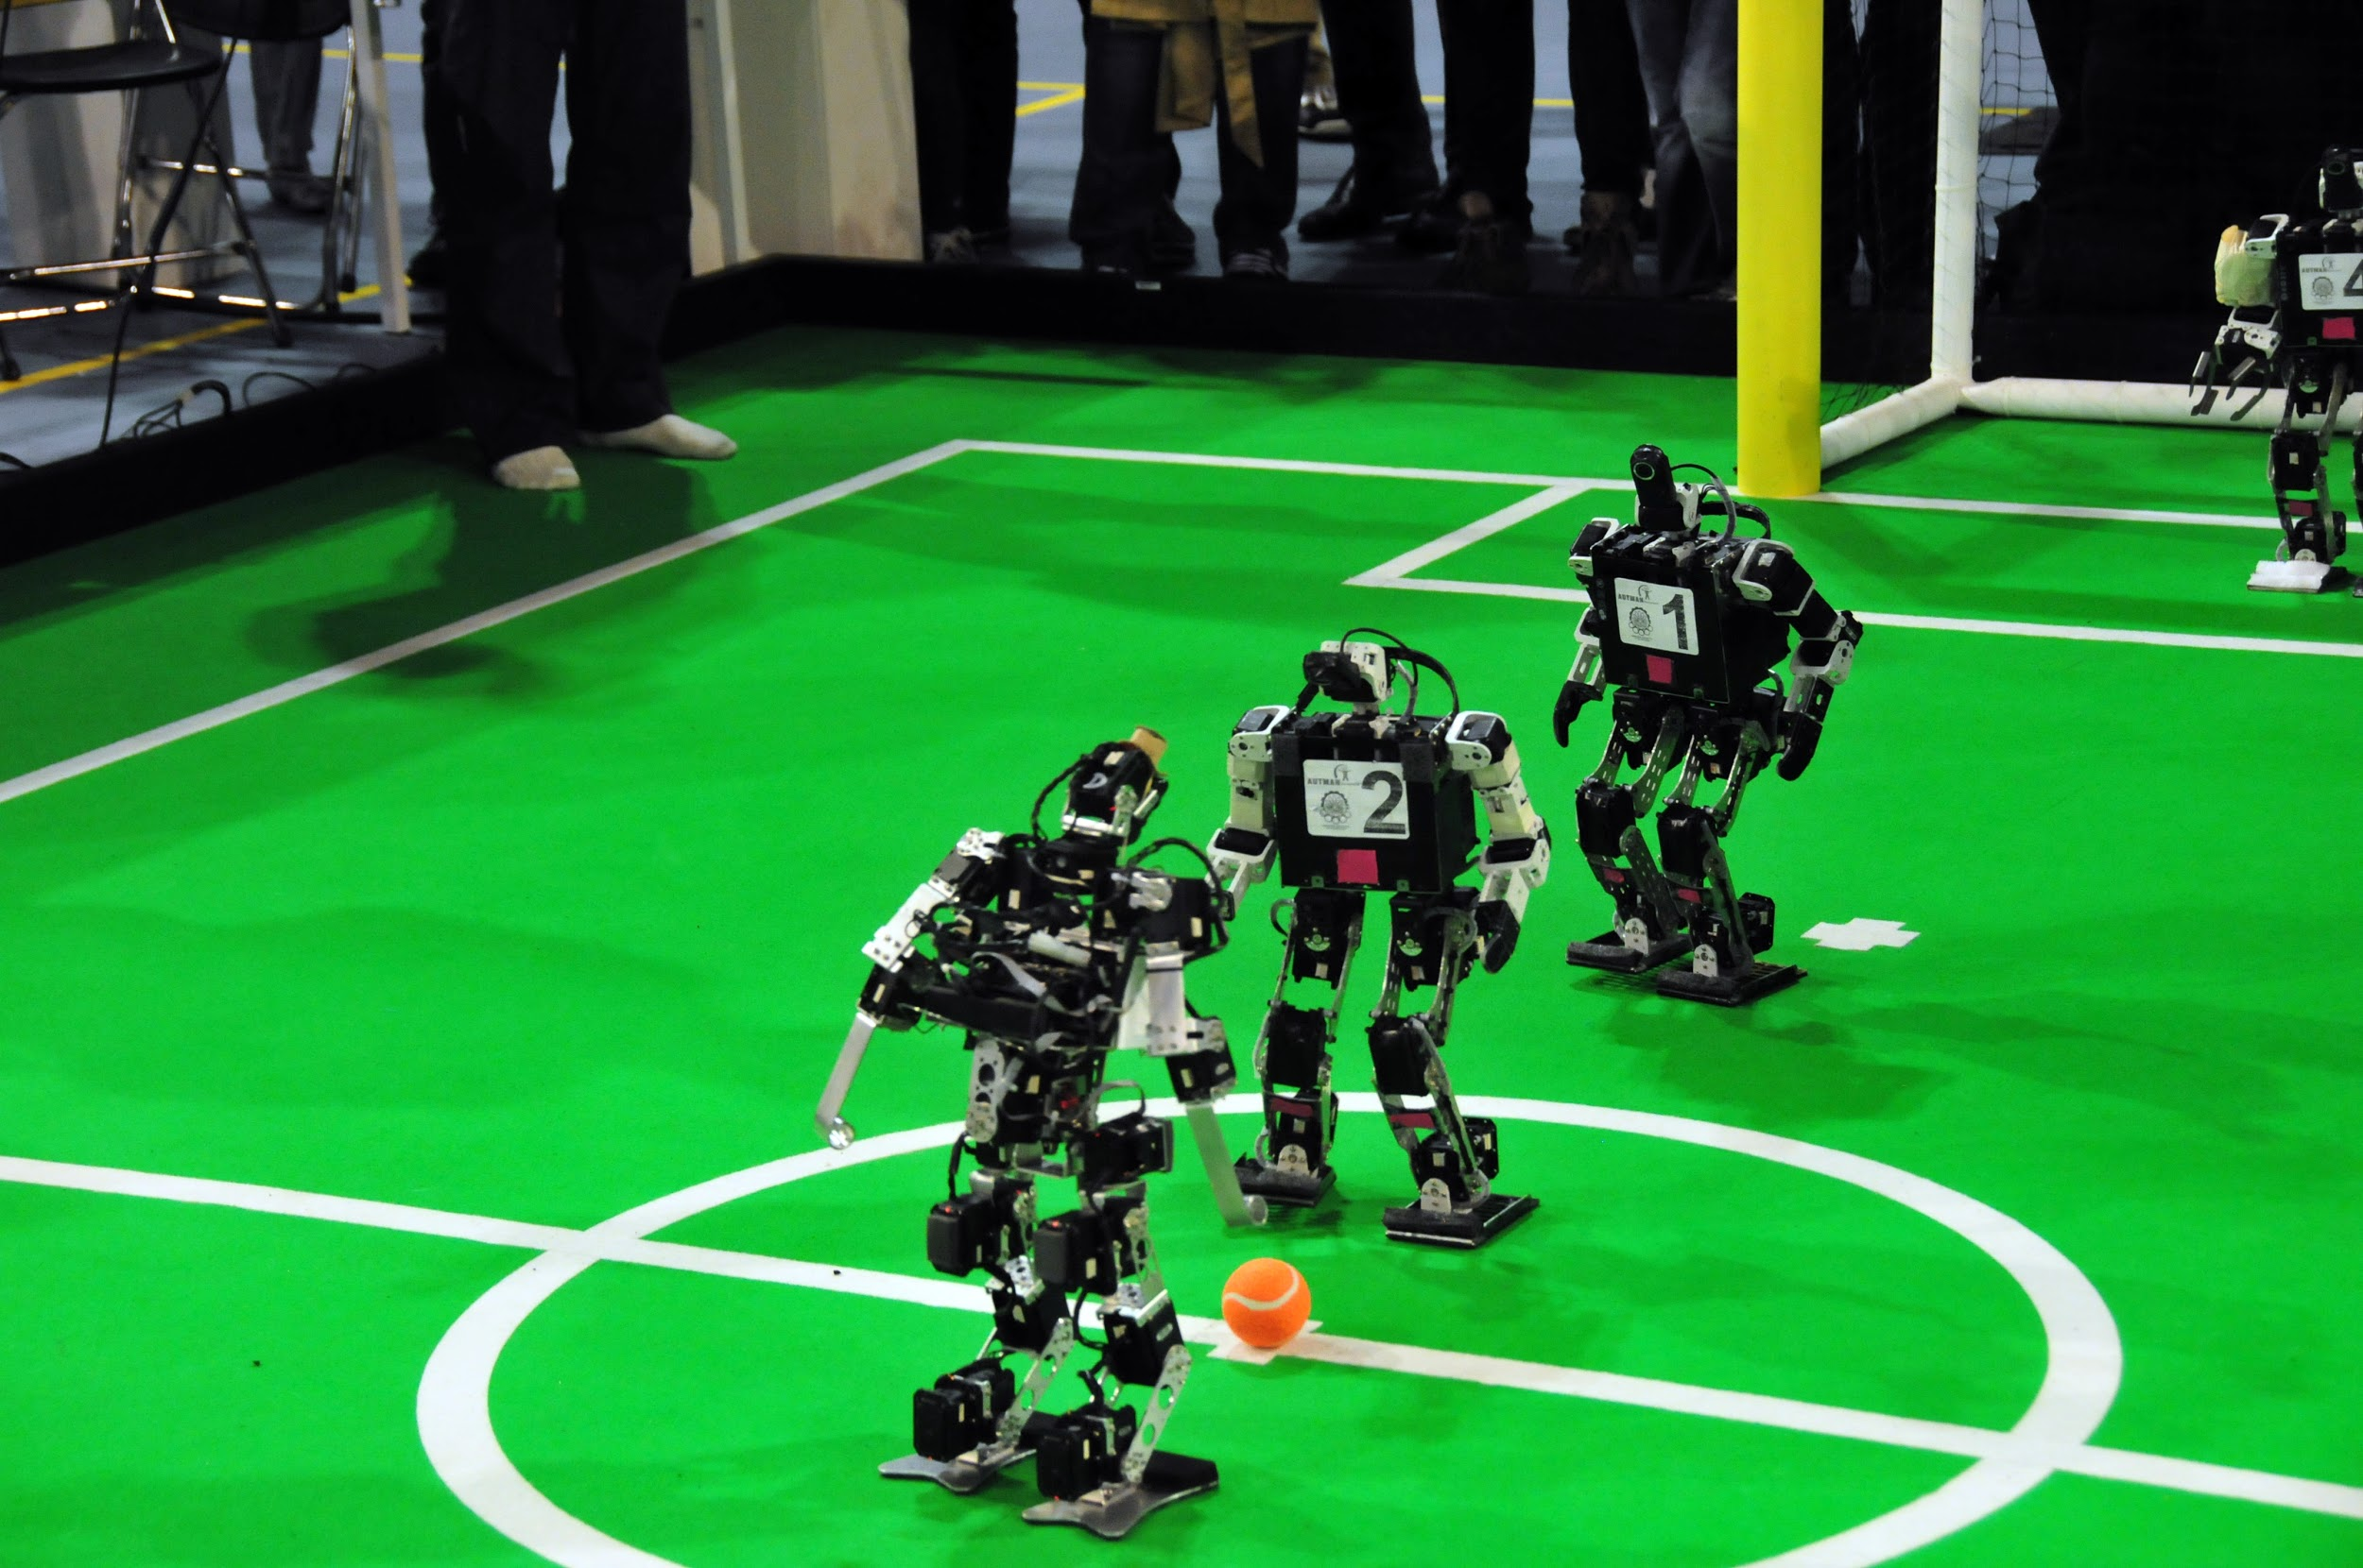
Robots do different exercises as humans because we need to get fit and they don’t
Yes
Do Robots get exercise?
Do jobs - carrying things
Box in a ring- battle-bots

Slide 9
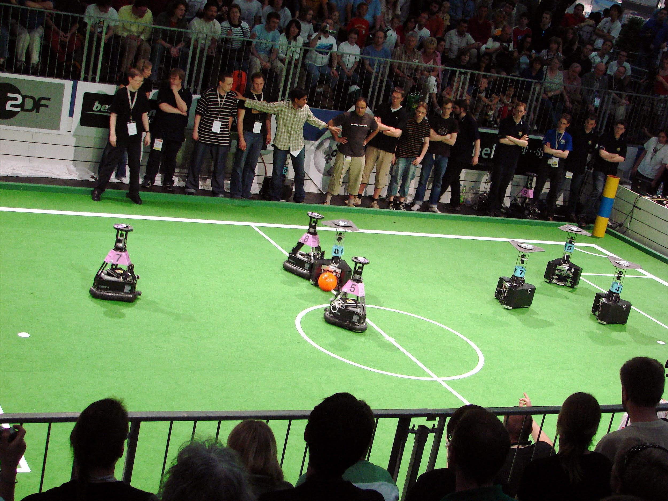
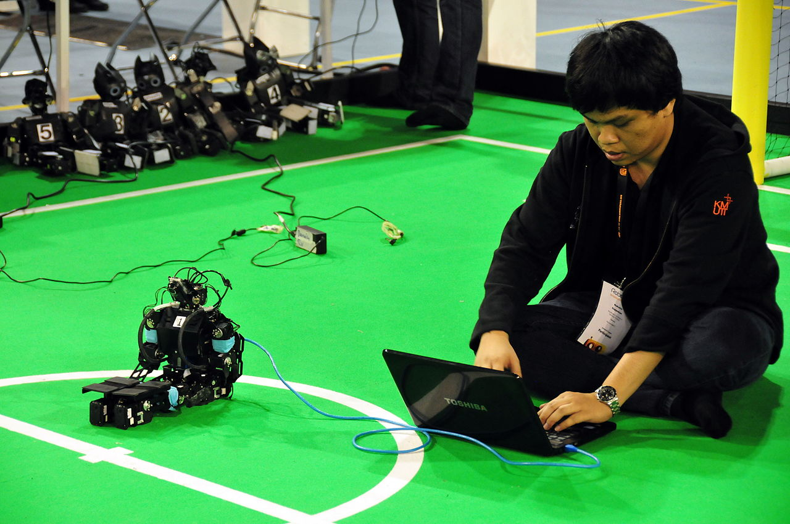
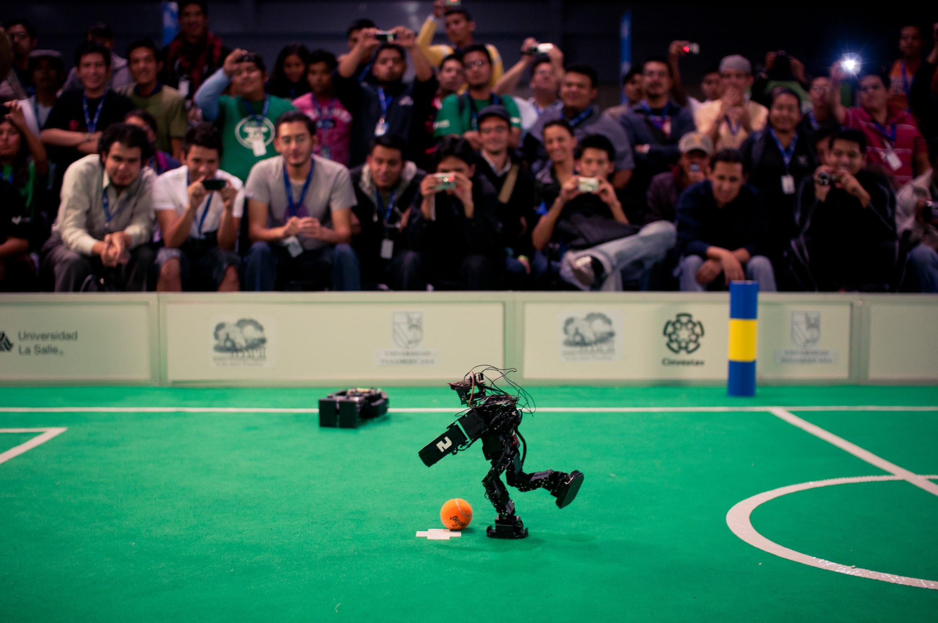
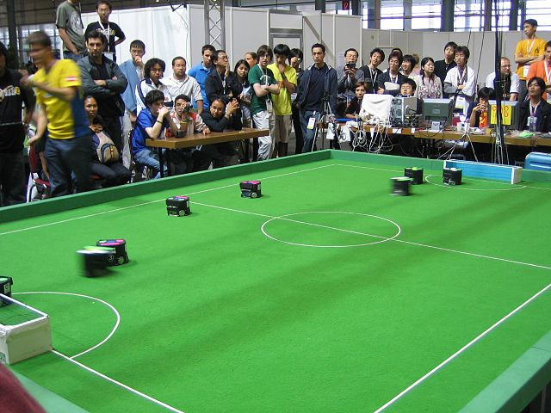
Robocup
The robocup is soccer but robots do it. The robots get controlled by a human. At the beginning of the game there is a ball the robots try to get the most points before the timer goes off. There are two goals and two goalie for each team.

Slide 10
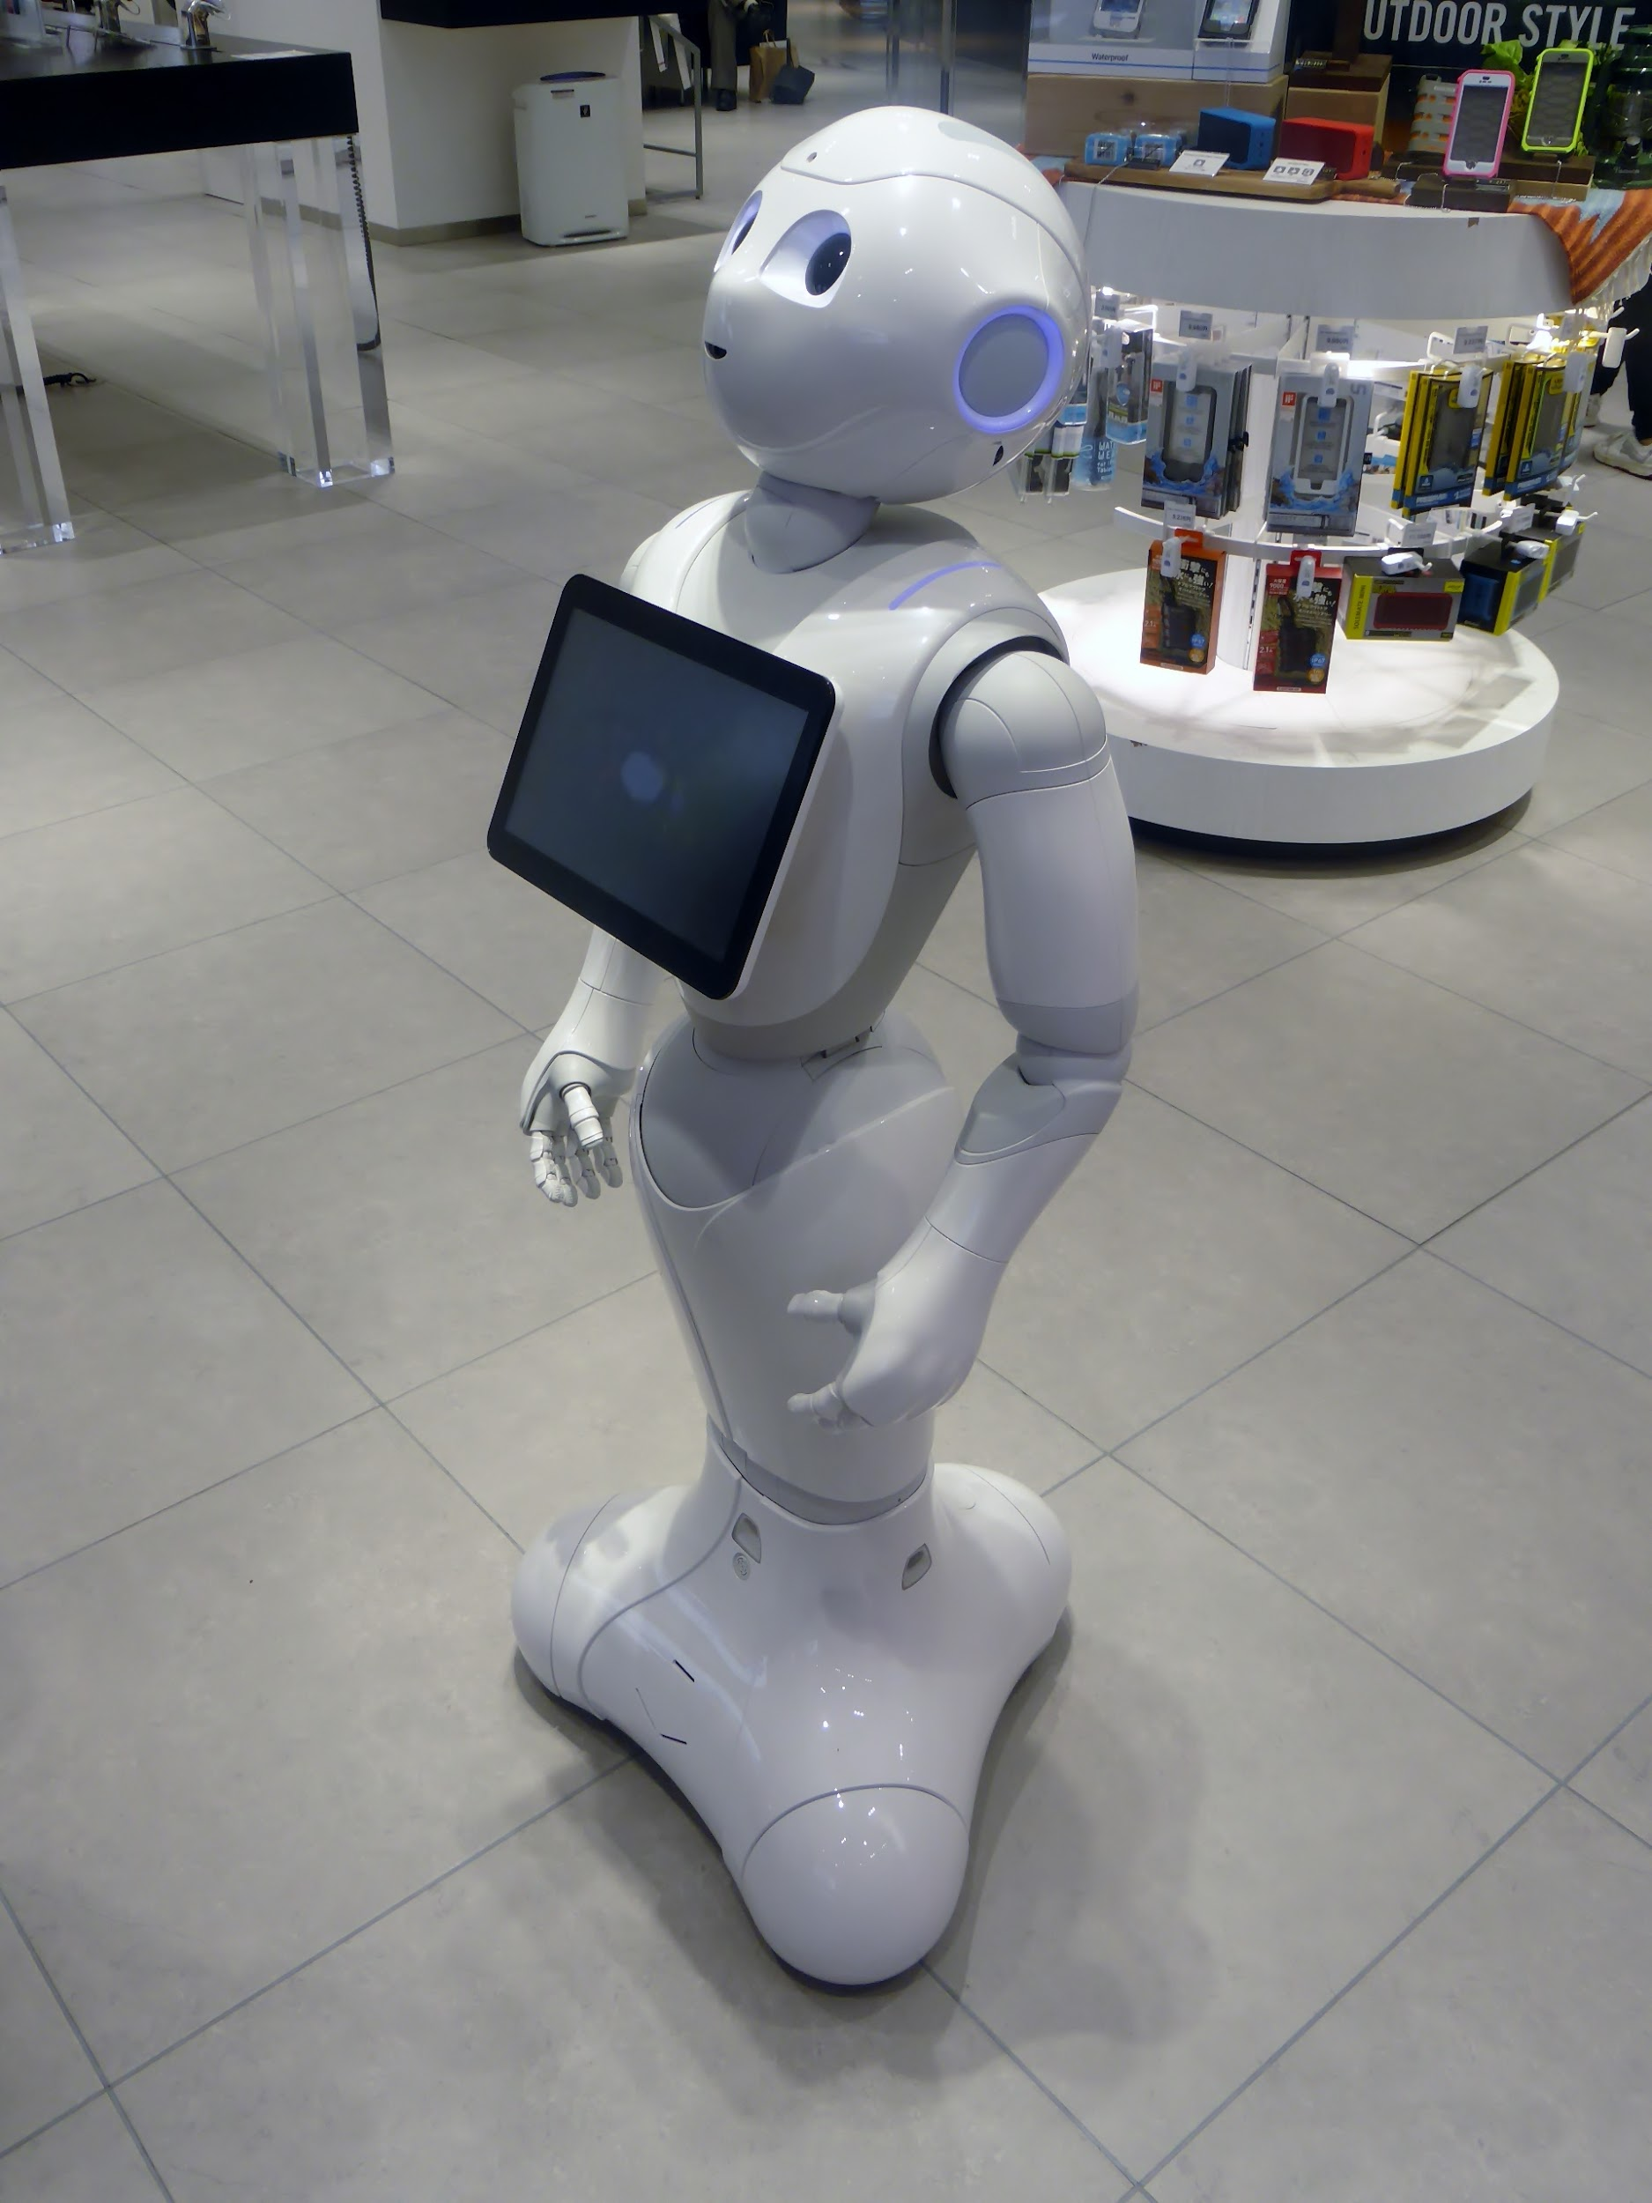
What are robots used for?
Food: Waiters, cooks, entertainment while you eat
Military: saving lives, sniffing out bombs or chemical poisons, keep watch over areas, missions without a person, hit enemies in exact spot, travel through dangerous places, detect dangerous places, break unexploded bombs, break windows
Household: pool cleaners, vacuum cleaners, lawn mowers, cleaning windows

Slide 11
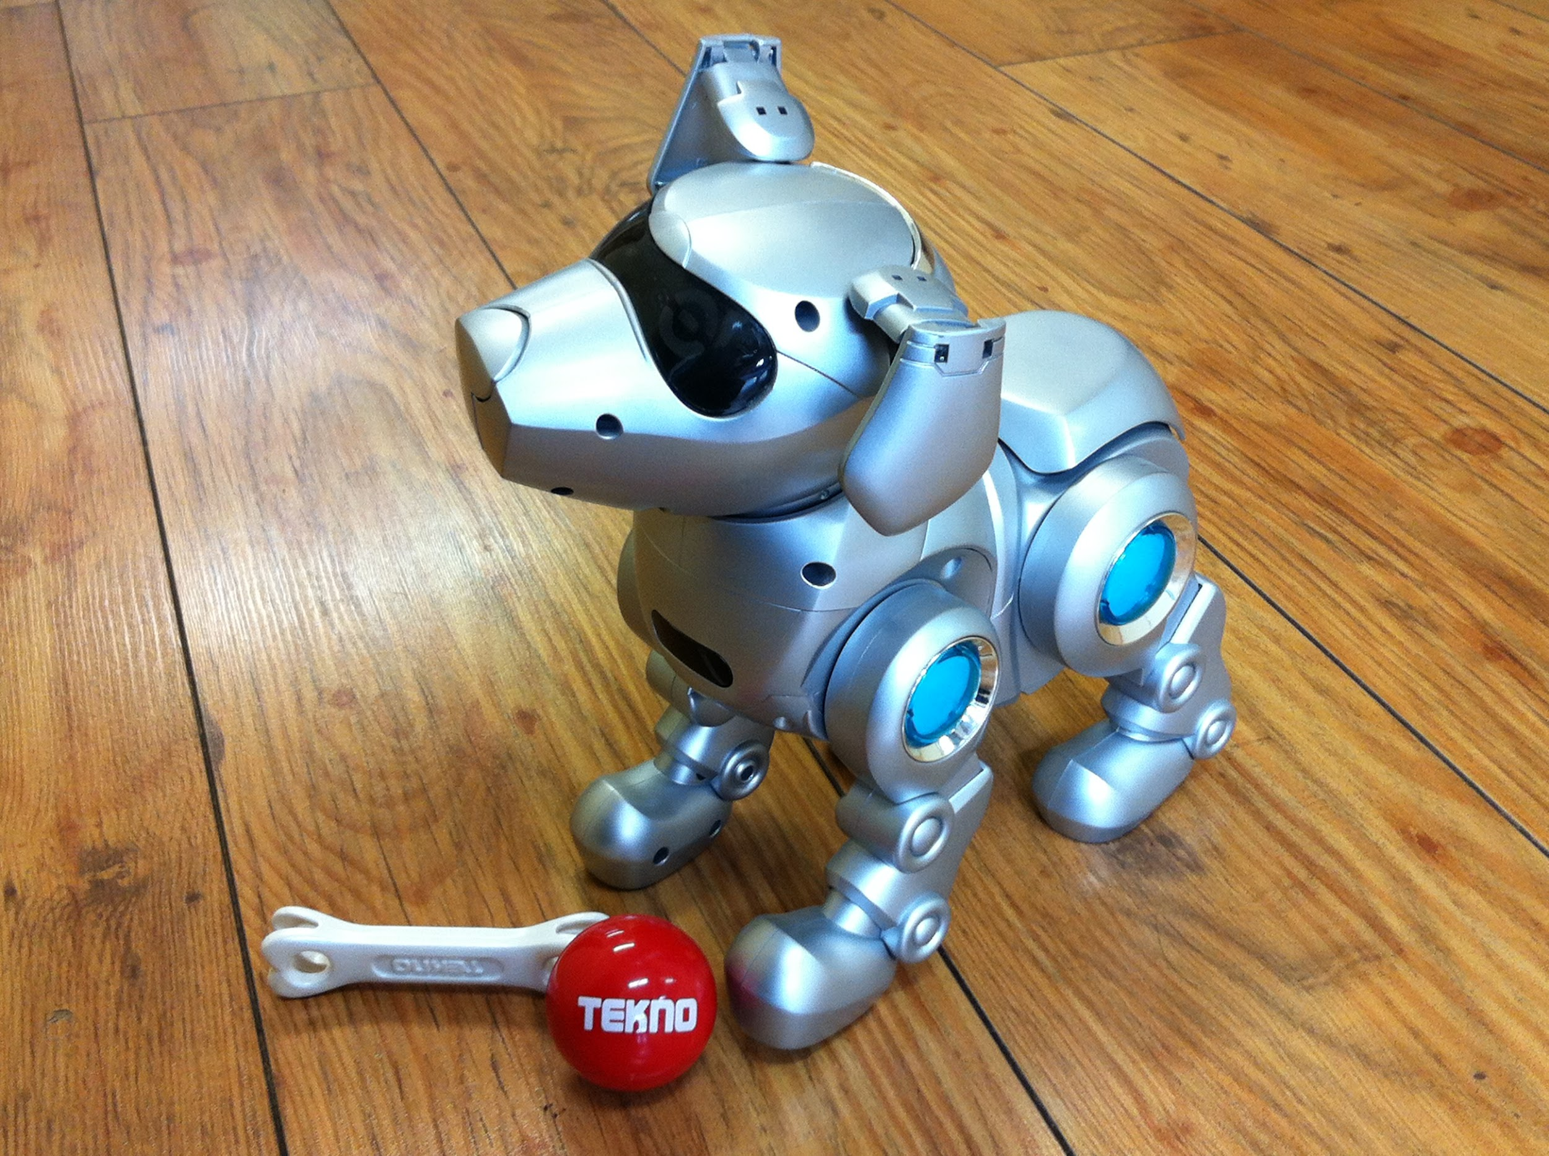
What are robots used for??
Medical: nurse bots, take care of old people, reach body parts, artificial limbs, perform surgery
Industry: welding, spray painting, transporting items, handling red hot metal, drilling tiny holes, spray fields, help carry things too heavy for people, work in places that people can’t work in
Entertainment: fast moving ball games, juggling balls, battlebots pets, underwater cameras, toys

Slide 12
Where do you find robots??
Manufacturing
Houses
Stores
Movies

Slide 13
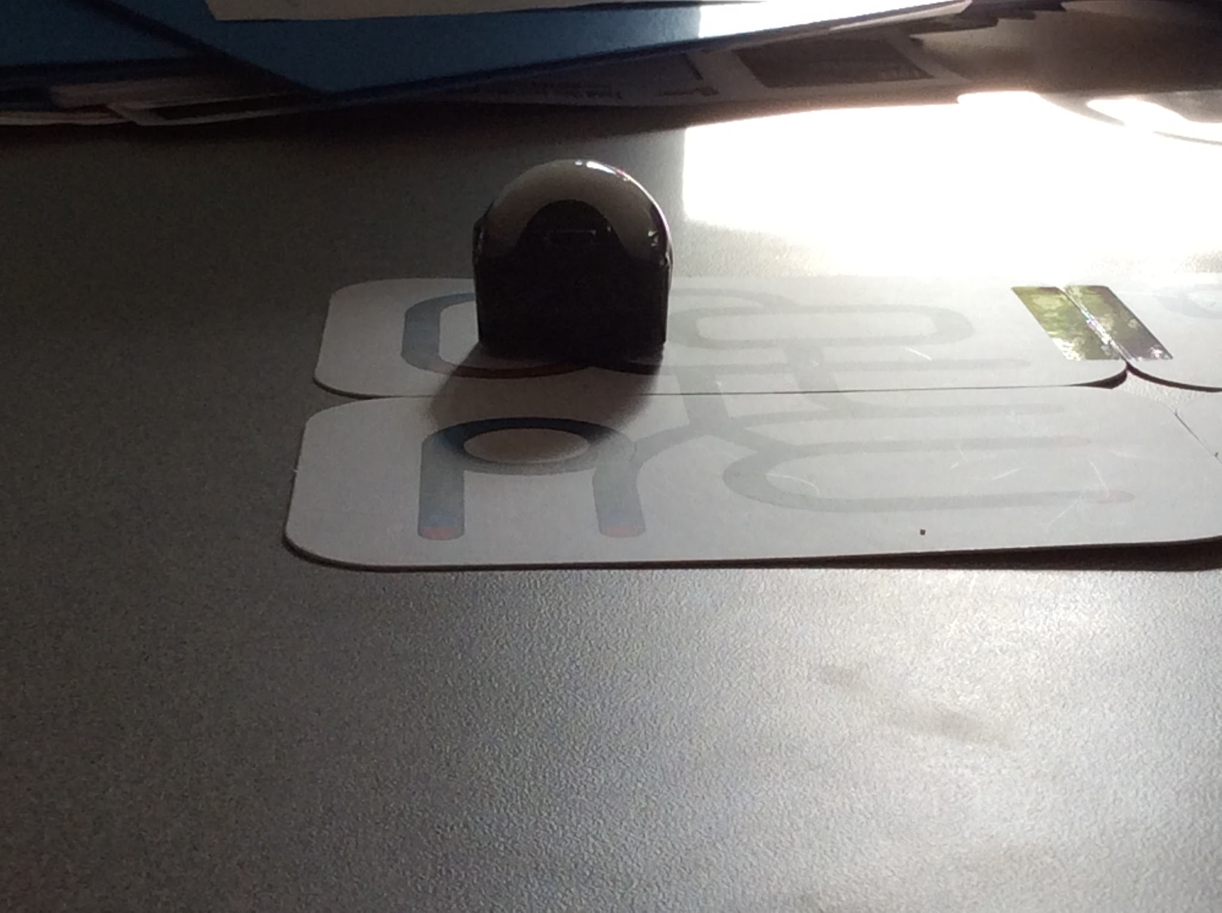
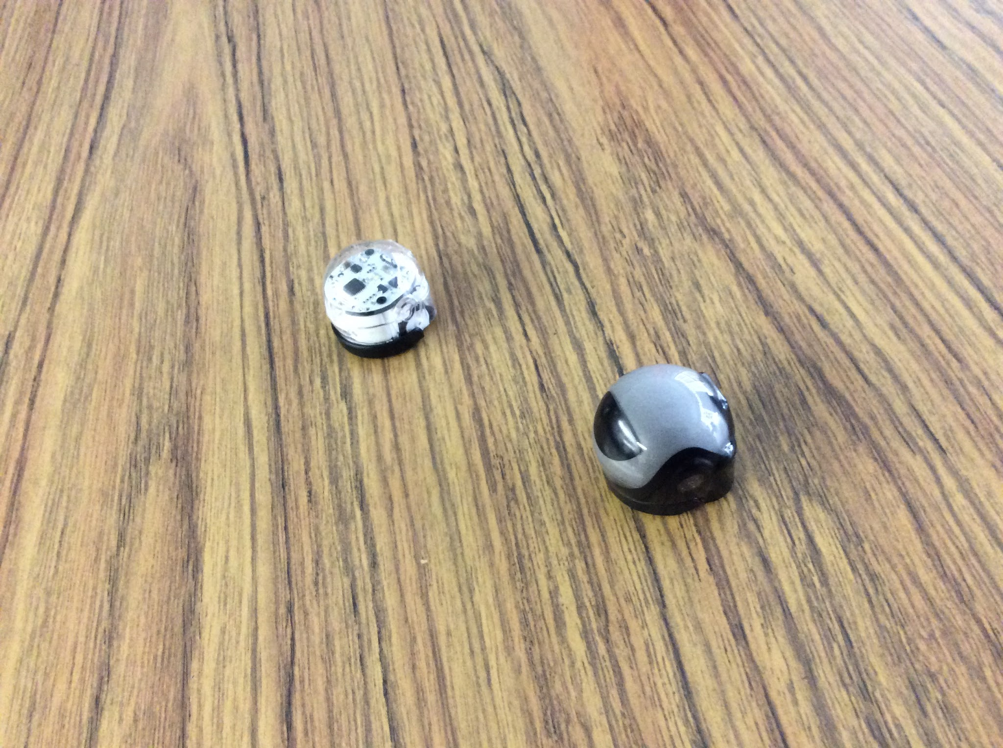
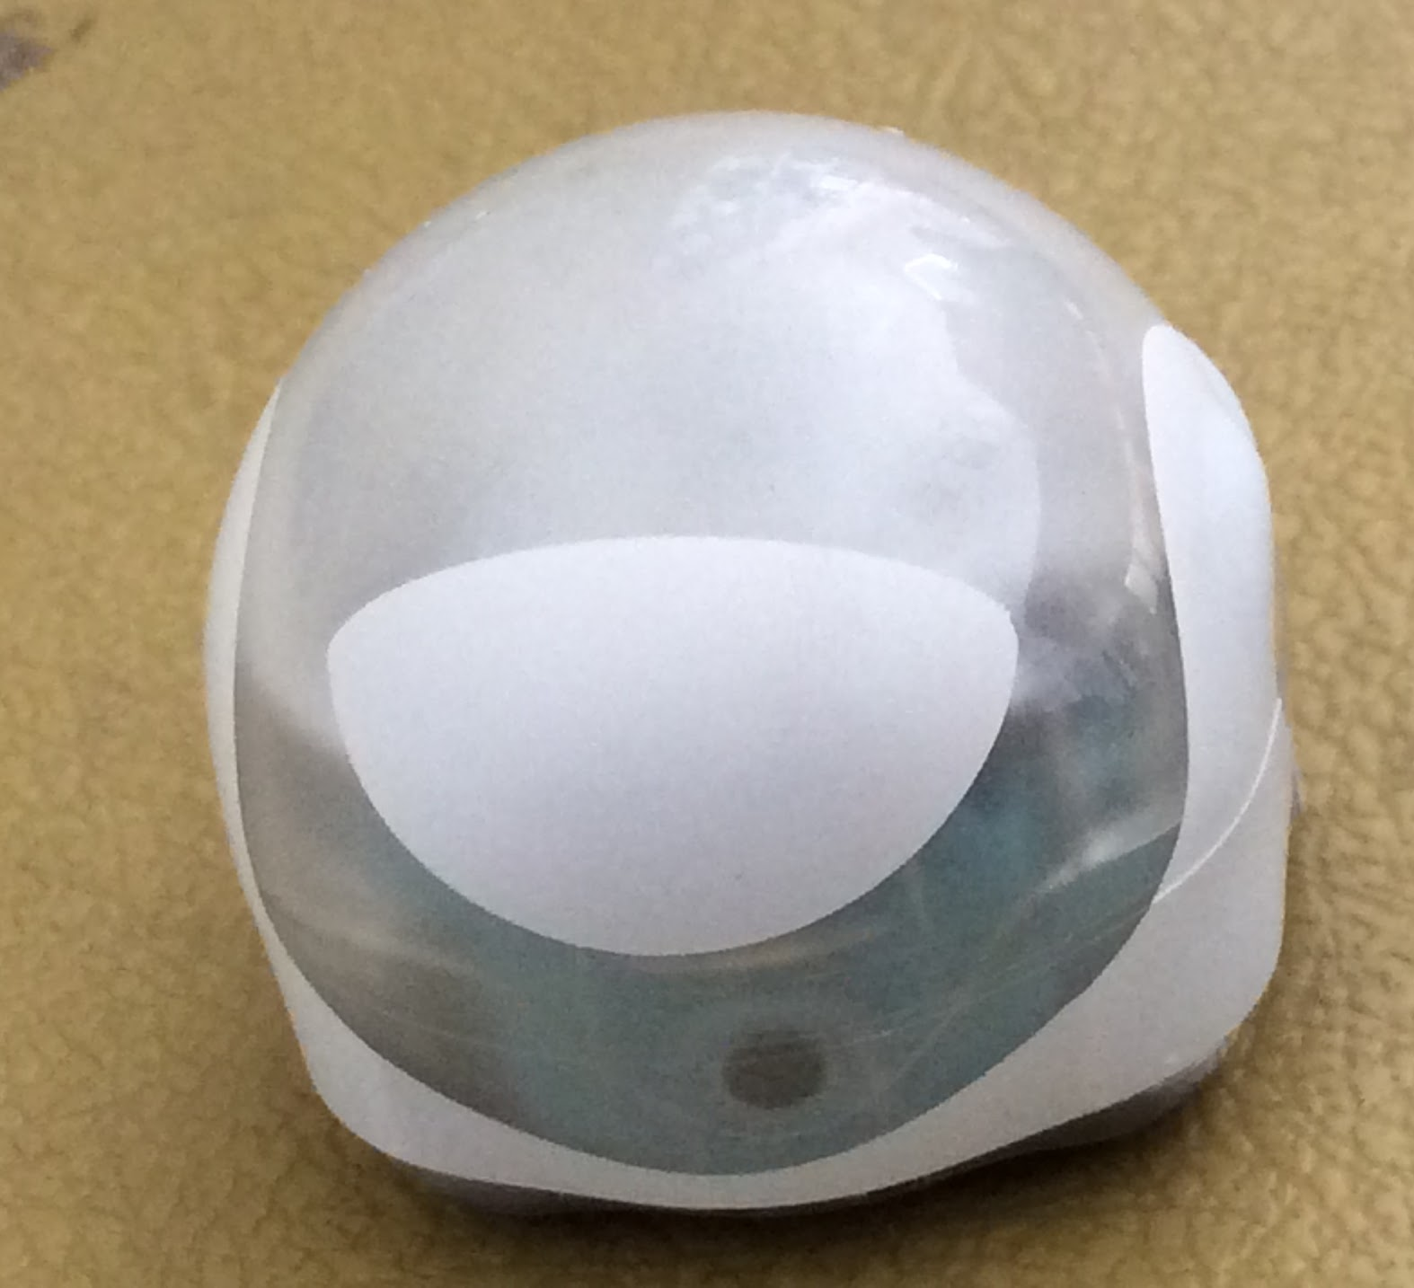
Hope Valley School has robots!
Ozobots!
Ozobot with skin (right) ozobot without skin (left)
Cool Blue Ozobots with OzoSkin
Black Ozobot with black OzoSkin on playground

Slide 14
Instructions for kids

Slide 15
Teacher’s guide to Ozobot

Slide 16
Sources:
Brasch, Nicolas. Robots And Artificial Intelligence, 2009.
Domaine, Helena. Robotics, 2016.
Faust, Daniel. Building Robots Robotic Engineers, 2016.
Gifford, Clive. Robots, 2005.
Ozobots. 2016. Ozobot & Evollve, Inc. <http://ozobot.com/play>.
Peppas, Lynn. Robotics, 2015.
Robotics: Facts. 2016. Idaho Public Television. <http://idahoptv.org/sciencetrek/topics/robots/facts.cfm>.
The History Of Robotics. Jul 8 2016. Science Kids. <http://www.sciencekids.co.nz/sciencefacts/technology/historyofrobotics.html>.

Slide 17
Images used
https://en.wikipedia.org/wiki/Robotic_sensors
https://commons.wikimedia.org/wiki/File:QSH_%E2%80%93_Giant_Lilliput_Robot_%E2%80%93_Box_Inside.jpg
https://commons.wikimedia.org/wiki/File:RoboCore_Robot_Combat.jpg
https://commons.wikimedia.org/wiki/File:Karel_%C4%8Capek.jpg
https://commons.wikimedia.org/wiki/File:Grand_Central_Terminal_Clock.jpg
http://idahoptv.org/sciencetrek/topics/robots/facts.cfm.
http://idahoptv.org/sciencetrek/topics/robots/facts.cfm.
https://en.wikipedia.org/wiki/Pepper_(robot)
https://commons.wikimedia.org/wiki/File:Tekno_the_Robotic_Puppy.jpg
https://commons.wikimedia.org/wiki/File:RoboCore_Robot_Combat.jpg
https://en.wikipedia.org/wiki/Industrial_robothttps://commons.wikimedia.org/wiki/File:US_Navy_090226-N-7090S-272_Warren_Tibbs,_a_robot_operator_at_the_Navy_Explosive_Ordnance_Disposal_(EOD)_Technical_Division,_Indian_Head,_Md.,_uses_a_PlayStation_controller_to_demonstrate_the_maneuverability_of_the_Pac-Bot.jpg
https://docs.google.com/presentation/d/1NOfI1YkHUmoWxk-FMX5TNJ1WAIMPZRlZoWMfH-_9D5s/edit#slide=id.g1a7cae2e8d_1_0
https://simple.wikipedia.org/wiki/Microprocessor
https://commons.wikimedia.org/wiki/File:Schnittbild_drehnatrieb_01.jpg
https://upload.wikimedia.org/wikipedia/commons/7/70/Adafruit_BMP085_pressure_sensor_module.jpg
https://pixabay.com/en/pop-x2-microcontroller-arduino-inex-1699988/
https://www.flickr.com/photos/intelfreepress/7791649188
https://commons.wikimedia.org/wiki/File:Sonar_Principle-cs.svg
https://en.wikipedia.org/wiki/RoboCup
https://www.flickr.com/photos/nakeddekan/3586249328

Slide 18
Images used
https://commons.wikimedia.org/wiki/File:Razer_side-on_view.jpg
https://www.flickr.com/photos/billward/3393261047
https://en.wikipedia.org/wiki/Robotica
https://commons.wikimedia.org/wiki/File:13-06-28-robocup-eindhoven-005.jpg
https://commons.wikimedia.org/wiki/File:13-06-28-robocup-eindhoven-102.jpg
https://commons.wikimedia.org/wiki/File:Small_size_robocup.jpg
https://commons.wikimedia.org/wiki/File:Robocup_Robots_Futbolistas_(4892794535).jpg
https://commons.wikimedia.org/wiki/File:MSL_robocup_2006.jpg
https://en.wikipedia.org/wiki/Robot
https://en.wikipedia.org/wiki/Synthetic_setae

